Slide 1
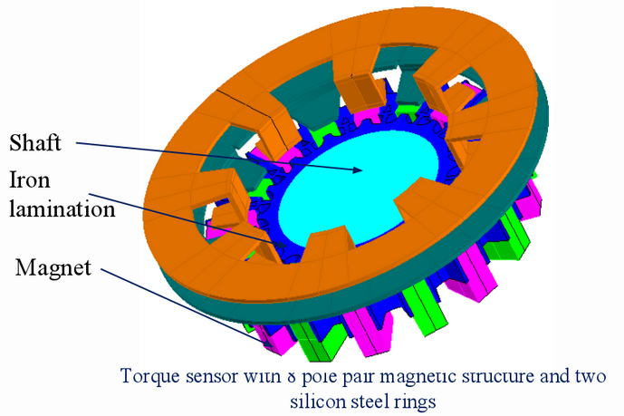
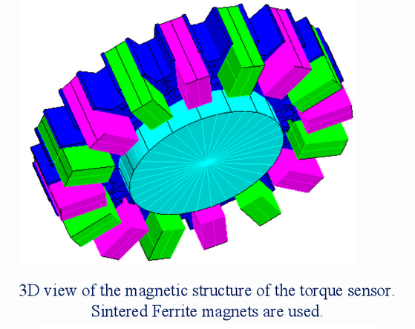
Axial Magnetic Design w/o rare earth
Radial URA:
12 rare earth magnets ($0.72)
Lam stack
Over mold
Axial URA:
14 ferrite magnets ($0.34)
Lam stack
Over mold
Radial LRA: 2 PhFe stators ($0.27 each)
Axial LRA: 2 SiFe stators($0.14 each)
Initial Proto testing:
Gain OK (linearity not as good as current sensor)
1/rev high (may be do to poor proto quality)
2nd round of testing complete
Gain OK (linearity not as good as current sensor)
1/rev much improved but higher then current sensor
1

